Slide 1

JBI model of evidence based health – protocol for systematic scoping reviewes.
Professor Preben Ulrich Pedersen, RN, Ph.D. Danish Centre for Systematic Reviews – a JBI Centre of excellence
På hver slide skal du trykke på højtaler symbolet for at høre lyden

Slide 2
Indhold
Kort præsentation af JBI
Præsentation af JBI Model of Evidence Based Healthcare med focus på scoping review

Slide 3

The Joanna Briggs Institute
Evidence Based Practice
Research Institute since 1996
Royal Adelaide Hospital and the University of Adelaide
Not-for-profit
70+ Centres and Groups, >7000 members in over 47 countries
Global Leader
Notes:
JBI is recognised as a global leader in EBHC. The institute was founded and began in 1996 and is based in the Royal Adelaide Hospital. The JBI is a single discipline School within the Faculty of Health Sciences at the University of Adelaide.
The JBI is a Not-for-profit research institute with over 60 Collaborating and Affiliate Centres and Collaborating Groups;
Over seven thousand (7000) subscribing health services and university members in forty seven (47) counties;
All-of-country/state membership in 20 countries/states: Spain, Scotland, Singapore, Hong Kong, Botswana, Burkina Faso, Cameroon, Ethiopia, Ghana, Kenya, Malawi, Nigeria, Rwanda, Swaziland, Tanzania, Uganda, Zimbabwe, Tasmania, Northern Territory and Australian Capital Territory.

Slide 4
International organisationer der fremmer evidens inden for sundhede
Joanna Briggs Institute,
  Alle sundheds professioner
Cochrane Collaboration
  I begyndelsen mest for læger
Campbell Collaboration
  Social arbejde

Slide 5
Europæiske JBI centre
Danmark: Centre of Clinical Guidelines Aalborg University - Danish Centre of Systematic Reviews: A Joanna Briggs Institute Centre of Excellence
Schweitz, Spanien, Belgien, UK, Finland, Rumænien, Czech Republic, Portugal, Norge

Slide 6
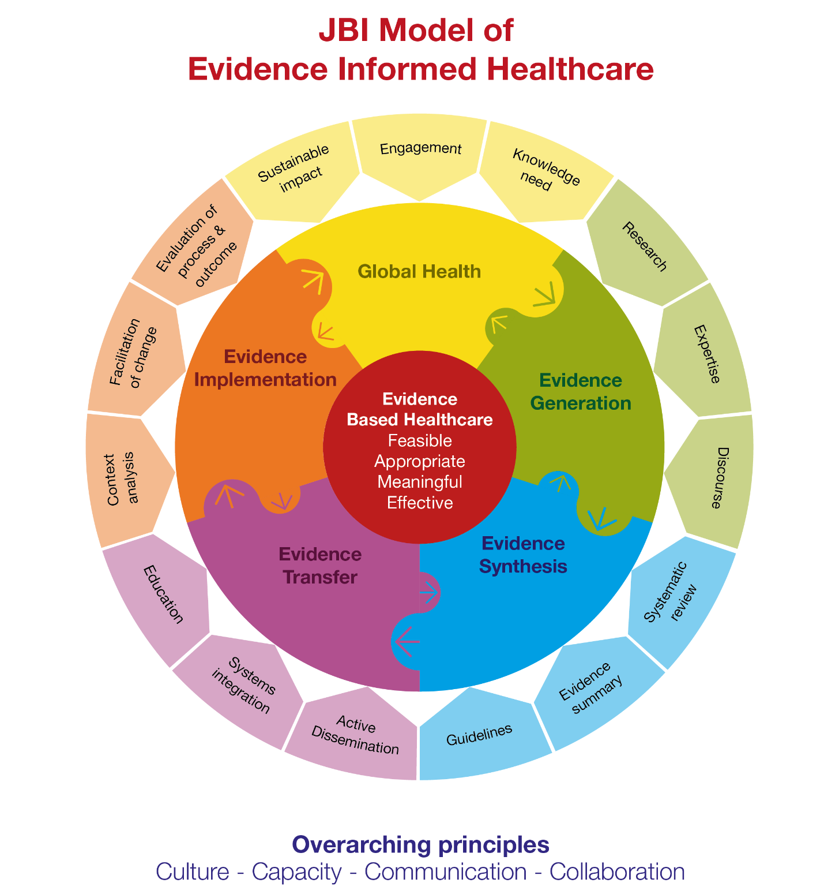

Slide 7
Essential Steps in EBP
Convert information needs into answerable questions (to formulate the problem);
Track down the best evidence with which to answer these questions;
Appraise the evidence critically to assess its validity (closeness to the truth) and usefulness (clinical applicability);
Implement the results in practice; and
Evaluate performance. (Sackett & Haynes, 1995)
Notes:
These are the five steps to EBP, recognised internationally - indicate how the JBI approach fits in with and complements these ideas, and provides resources to enable these steps to occur. This model leads into the the Joanna Briggs Module of Evidence Based Health Care which we will explore in some detail in the next session.

Slide 8
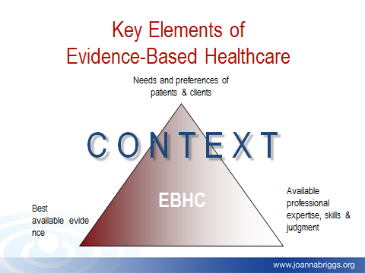
Meaningfulness
Feasibility
Appropriateness
Effectiveness

Slide 9
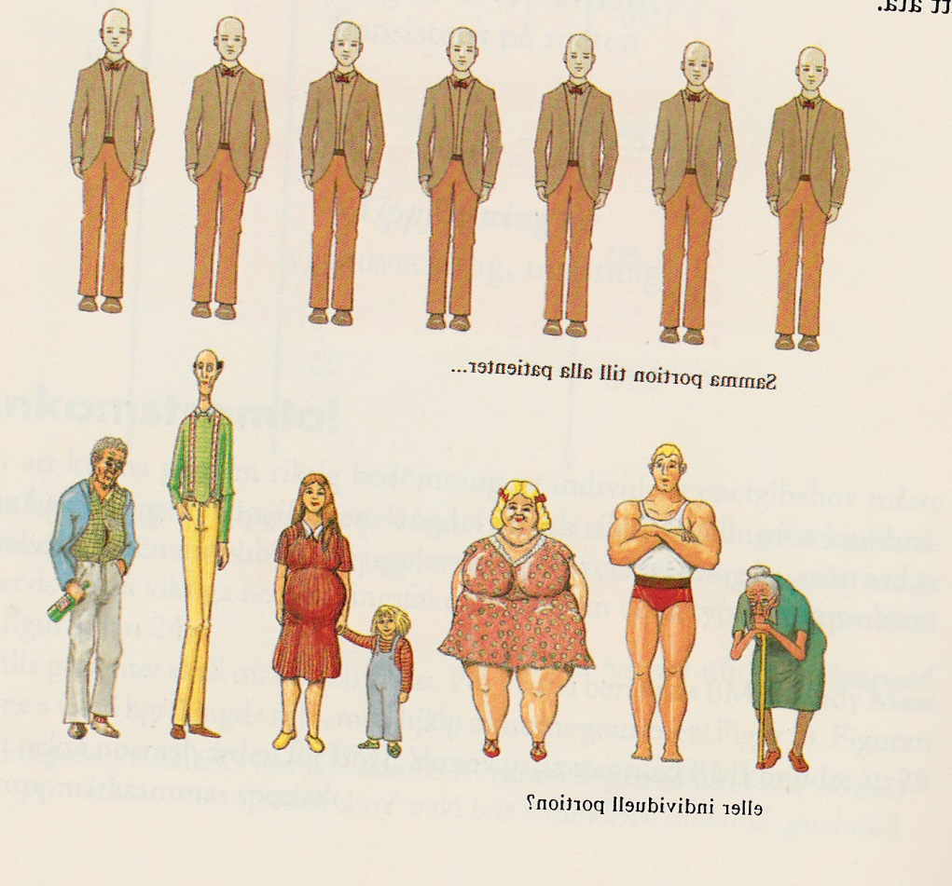
Aggregated vs individual level

Slide 11
Global Health
…to identify and adress concerns that arise out of the experiences of patients/clients, the user of health care, healthcare professionals and families.. To generate evidence that will effectively and appropriately meet these identified needs..

Slide 13
Evidence generation
Research – all kind
Discourse - ethical consideration
Expertise
  Patients' and relatives experiences, preferences, needs, values
  Staff - knowledge - not just any experience – aggregated systematically until consensus
  Skills – through clinical leadership

Slide 17

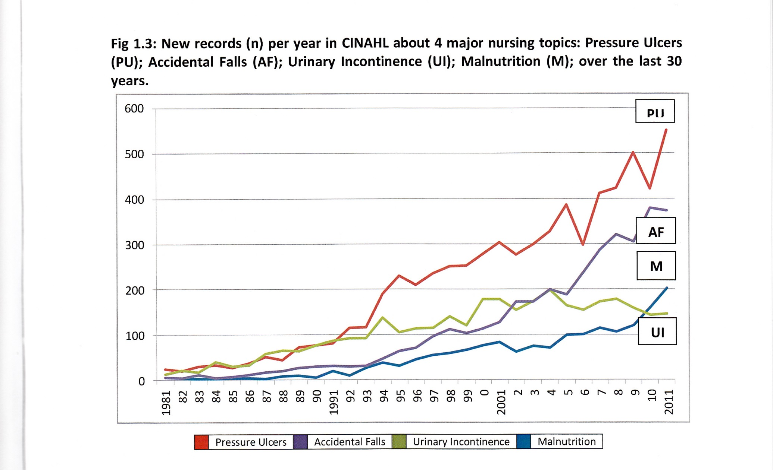


Geruder, B, 2014
CENTER FOR KLINISKE RETNINGSLINJER
^{- CLEARINGHOUSE}
^{www.cfkr.dk}

Slide 18
Scoping reviews vs Systematiske reviews – JBI manual
Table 11.1: Defining characteristics of traditional literature reviews, scoping reviews and systematic reviews
 | Traditional Literature Reviews | Scoping reviews | Systematic reviews
A priori review protocol | No | Yes (some) | Yes
PROSPERO registration of the review protocol | No | No | Yes
Explicit, transparent, peer reviewed search strategy | No | Yes | Yes
Standardized data extraction forms | No | Yes | Yes
Mandatory Critical Appraisal (eg. Risk of Bias Assessment, Checklist: Critical appraisal of qualitative research) | No | No | Yes
Synthesis of findings from individual studies and the generation of ‘summary’ findings (quantitative, qualitative) | No | No | Yes

Slide 20
Formål Scoping review
…scoping reviews can be used
  to map the key concepts that underpin a field of research,
  to clarify working definitions,
  to map the conceptual boundaries of a topic,
  to 'map' of the available evidence can be undertaken as a preliminary exercise prior to the conduct of a systematic review,
  to examining emerging evidence when it is still unclear what other, more specific questions can be posed for evidence syntheses (eg. Patients’ experiences with an intervention),
  to identify instruments with-in a specific area,
  JBI – Reviewers manual

Slide 21
Scoping reviews - udvikling
*Consultation of information scientists, stakeholders and/or experts throughout, including in the topic prioritization, planning, execution and dissemination
 | Arksey and O’Malley framework (2005, p. 22-23) | Enhancements proposed by Levac et al. (2010, p. 4-8) | *Enhancements proposed by Peters et al (2015, 2017, 2020).
1. | Identifying the research question | Clarifying and linking the purpose and research question | Defining and aligning the objective/s and question/s
2. | Identifying relevant studies | Balancing feasibility with breadth and comprehensiveness of the scoping process | Developing and aligning the inclusion criteria with the objective/s and question/s
3. | Study selection | Using an iterative team approach to selecting studies and extracting data | Describing the planned approach to evidence searching, selection, data extraction, and presentation of the evidence.
4. | Charting the data | Incorporating a numerical summary and qualitative thematic analysis | Searching for the evidence
5. | Collating, summarizing and reporting the results | Identifying the implications of the study findings for policy, practice or research | Selecting the evidence
6. | Consultation (optional) | Adopting consultation as a required component of scoping study methodology | Extracting the evidence
7. |  |  | Analysis of the evidence
8. |  |  | Presentation of the results
9. |  |  | Summarizing the evidence in relation to the purpose of the review, making conclusions and noting any implications of the findings

Slide 22
JBI Reviwers manual
About this Manual
Contributors
Chapter 1: JBI Systematic Reviews
Chapter 2: Systematic reviews of qualitative evidence
Chapter 3: Systematic reviews of effectiveness
Chapter 4: Systematic reviews of text and opinion
Chapter 5: Systematic reviews of prevalence and incidence
Chapter 6: Systematic reviews of economic evidence
Chapter 7: Systematic reviews of etiology and risk
Chapter 8: Mixed methods systematic reviews
Chapter 9: Diagnostic test accuracy systematic reviews
Chapter 10: Umbrella reviews
Chapter 11: Scoping reviews

Slide 23
Kilde
The JBI Model of Evidence-based Healthcare: A model reconsidered
https://joannabriggs.org/assets/docs/approach/The_JBI_Model_of_Evidence_-_Healthcare-A_Model_Reconsidered.pdf
Reviwers manual JBI
https://wiki.joannabriggs.org/display/MANUAL/JBI+Reviewer%27s+Manual

Slide 24
Kilder fortsat
Pedersen PU, Tracey A, Sindby JE, Bjerrum M. Preoperative oral hygiene recommendation before open-heart surgery: patients’ adherence and reduction of infections: a quality improvement study. BMJ Open Quality 2019;8:e000512. doi:10.1136/ bmjoq-2018-000512
Preben U Pedersen, Palle Larsen, Sasja Jul Håkonsen. The effectiveness of systematic perioperative oral hygiene in reduction of postoperative respiratory tract infections after elective thoracic surgery in adults: a systematic review. JBI Database of Systematic Reviews & Implementation Reports 2016;14(1):140-173
Pedersen PU, Larsen P, Håkonsen SJ, Bjerrum MB. Fra Forskning til praksis. København 2017, Munksgaard.
Kari Ingstad, Lisbeth Uhrenfeldt, Ingjerd Gåre Kymre, Conni Skrubbeltrang, Preben Ulrich Pedersen. Scoping review protocol: effectiveness of individualised nutritional care plans to reduce malnutrition during hospitalisation and up to 3 months after discharge. BMJ Open 2019;9:e032615. doi:10.1136/bmjopen-2019-032615
Sasja Jul Håkonsen, Preben Ulrich Pedersen, Merete Bjerrum. Ann Bygholm, Micah D J Peters. A nursing minimum dataset for documenting nutritional care for adults in primary healthcare: a scoping review protocol. JBI Database of Systematic Reviews & Implementation Reports. 2015;13(8) 92 – 100
Håkonsen SJ, Pedersen PU, Bjerrum M, Bygholm A, Peters MDJ. Nursing Minimum Data Sets for documenting nutritional care for adults in primary healthcare: a scoping review. JBI Database System Rev Implement Rep. 2018 Jan;16(1):117-139. doi: 10.11124/JBISRIR-2017-003386.

