Slide 1
JBI Scoping Reviews
“WIDS’IT’”- Walsh, 2016 (personal communication)
Presented by Micah Peters
micah.peters@adelaide.edu.au

Slide 2
Outline
Indications
Objectives, Questions, Inclusion Criteria
A brief model of scoping reviews
Frameworks for scoping reviews
Breadth not quality
Implications for research, policy, and practice

Slide 3
Indications
Map disparate or unknown evidence
Precede a systematic review
Map concept use
Map how research has been done
Develop a policy map
Gaps analysis

Slide 4
Objectives and Questions
Research objectives and Review objectives
Congruence between objectives
  Do you have the right review objective for your research objective?
Review Objectives and Questions
  Are you asking the right questions?
Questions and Sub-questions
  How many questions do you have?

Slide 5
Questions and Inclusion Criteria
Congruence between questions and review inclusion criteria
  Do you have the right parameters to find the right evidence?
  P - opulation
  C - oncept
  C - ontext

Slide 6
A model
Scoping the evidence
Synthesising the evidence

Slide 7
A model
Synthesising the evidence
Scoping the evidence

Slide 8
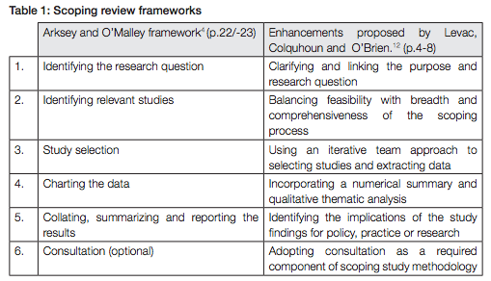
Previous Frameworks

Slide 9
The JBI Framework
1. Identifying the research objective
2. Clarifying the review objective and questions
3. Determining the inclusion criteria
4. Developing the a-priori protocol
5. Searching for and identifying the evidence
6. Extracting the Data
7. Mapping the Data
8. Discussing the Evidence
9. Making conclusions and giving recommendations

Slide 10
What?! No critical appraisal?!
Breadth of the evidence, not the quality
Implications for policy and practice?
Implications for research
  - Primary research
  - Secondary research

Slide 11
Methodological discussion, support, and publishing JBI Scoping Reviews
Joannabriggslibrary.org
jbi.synthesis@adelaide.edu.au
micah.peters@adelaide.edu.au
- Scoping review protocol template

Slide 12


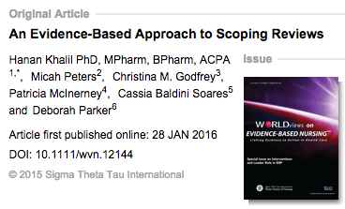
Further reading
JBI Scoping Reviews Methodology Chapter

Slide 13
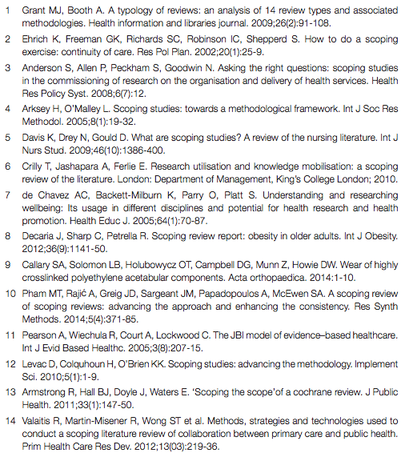
More further reading

