Slide 1
Review typer
Palle Larsen MScN, Ph.d.,
Post.doc
Center for Kliniske retningslinjer
Aalborg Universitet

Slide 2

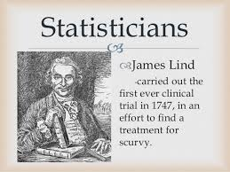
Archie Cochrane, a famous British epidemiologist,
noted:
‘It is surely a great criticism of our profession that
we have not organized a critical summary, by
specialty or subspecialty, adapted periodically, of
all relevant randomized controlled trials.’
The advent of evidence-based practice (EBP) in
the early 1990s has seen the role of the health
library and information worker in the ascendancy,
with clinicians increasingly relying on health care
literature in their decision making
While it is well established that, in the 18th century,
James Lind was the instigator of the first reported
RCT, a lesser-known fact records that he was probably
the first to describe the systematic review method.

Slide 3
Metode
I dette arbejde er systematisk søgt litteratur ud fra søge termerne:
Different Review types in Evidencebased Health care
1 udvalgt:
Grant MJ, Booth A. A typology of reviews: an analysis of 14 review types and associated methodologies. Health Info Libr J. 2009 Jun;26(2):91-108. doi: 10.1111/j.1471-1842.2009.00848.x. Review. PubMed PMID: 19490148.
Dette bygger på 17 forskellige primærstudier
(Search, Appraisal, Synthesis and Analysis (SALSA) framework)

Slide 4
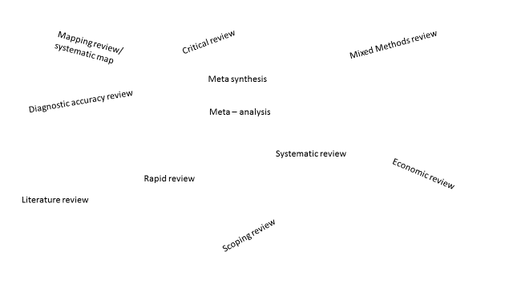
Review typer

Slide 5
Critical Review

Slide 6
Literature review

Slide 7
Mapping review

Slide 8
Meta analysis

Slide 9
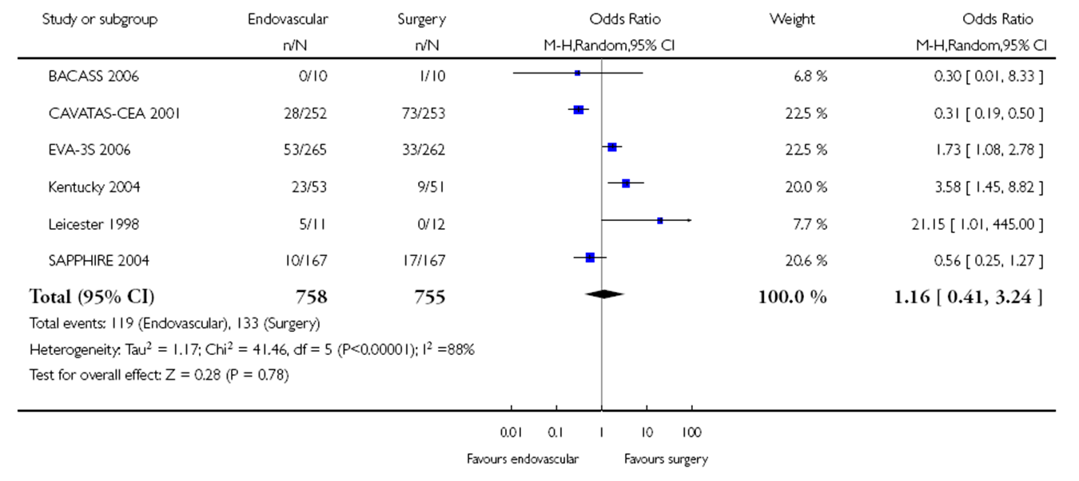

Slide 11
Mixed Methods Review

Slide 12
Overview

Slide 13
Qualitative systematic review

Slide 14
Rapid Review

Slide 15
Scoping Review

Slide 16
Systematic Review

Slide 17
Umbrella Review

Slide 18
Diagnostic Accuraty
Label | Descriptiom | Search | Apraisial | Synthesis | Analysis
Diagnostic accuraty | Diagnostic test accuracy studies compare a diagnostic test of interest (the ‘index test’) to an existing diagnostic test (the ‘reference test’), which is known to be the best test currently available for accurately identifying the presence or absence of the condition of inter | diagnostic studies generally use cross-sectional or case-control study designs | The process of critical appraisal examines the methodology of a study against pre-defined criteria, with the aim of identify sources of risk of bias and is used to evaluate the extent to which the results of a study should be believed or to be deemed valid after rigorous assessment (Reitsma et al., 2009) | Describes how the outcome data of the primary studies will be combined and eported, i.e. meta-analysis, narrative synthesis, graphical representation, | Meta-analysis of data from studies of diagnostic test accuracy is more complicated than most other forms of meta-analysis (principally due to the paired nature of the main outcome measures sensitivity/specificity) (JBI 2015)

Slide 19
Konklusion
Review er en systematisk sammenfatning af eksisterende viden
Hovedelementerne I arbejdet med review er:
Identifikation af klinisk problemstilling
Udarbejdelse af PICO/PICo/PCC, PIRO, etc
Systematisk litteratursøgning
Kritisk vurdering af litteraturen
Sammenfatning af viden baseret på de enkelte artiklers resultater/fund
Review er et væsentligt element I EBP, og danner fundamentet for udarbejdelse af kliniske retningslinjer og dermed for den kliniske beslutning

Slide 20
Tak for opmærksomheden!

